Slide 1
Fuego Test System
Roadmap and Priorities
Discussion
June 2018
Tim Bird
Fuego Maintainer
Sony Electronics

Slide 2
Outline
Old roadmap
What to work on next?
Projects in progress
Tim’s working on...
Daniel’s working on...
Liu’s working on...
Wang’s working on...
Discussion

Slide 3
Roadmap
Recent past → Near Future → Long Term

Slide 4
Roadmap
Recent past:
Features for LTS, CIP
Hardware control
Near future:
Documentation
Conversion to reStructuredText
Tutorials
Pre-built docker image
More tests for AGL, LTSI, CIP
Sharing of customizations

Slide 5
Roadmap (cont.)
Near future (cont.):
System provisioning support
Install of software under test
Has been out-of-scope for Fuego
e.g. AGL image deploy, LTSI kernel update, etc.
Full automation requires board management API
Long-term
Test store
Distributed test network
Hardware testing

Slide 6
What to work on next?
Things that slipped from the 1.3 release:
Documentation conversion
LTS Provisioning support
Pre-built docker
Short-term items
Test program build cache
FUEGO_NO_BOARD_CONNECT ??
More tests
Long-term items
Test server
ftc put-board

Slide 7
Projects in progress
Just a note:
This is open source...
THERE IS NO MASTER PLAN
Projects get done when individual developers work on them and contribute patches
I won’t tell you what to work on
Your priorities are your own
But of course we can have a shared vision...
If you need ideas, ask me.

Slide 8
Tim’s projects
Easy customization
Expected value customization (research)
save baseline, compare with baseline
ftc set-criteria (research)
Dynamic documentation (almost done)
Ability to integrate dynamic report into testcase documentation
Test program binary cache (new)
Build deployable tarballs for test program binaries
in /fuego-rw/cache/<platform>-<testname>-assets.tgz
May help with LAVA integration

Slide 9
Easy test customization
Customizable system state check
Ability to save a snapshot of system status or behavior
Example:
“I want the system to still have X”
“I want the system to continue to be able to do Y”
Make it very easy to capture state or behavior
Reduce maintenance of tests

Slide 10
Features in progress (slightly)
Fuego centralized test server
Share ad-hoc test (test package)
Request test on someone else’s board
Has been on backburner
Share customizations
Share results

Slide 11
Daniel’s projects
dynamic variables
using ftc from jenkins
publishing run.json and artifacts to Squad
argparse
trinity (fuzzing test)
useful scripts

Slide 12
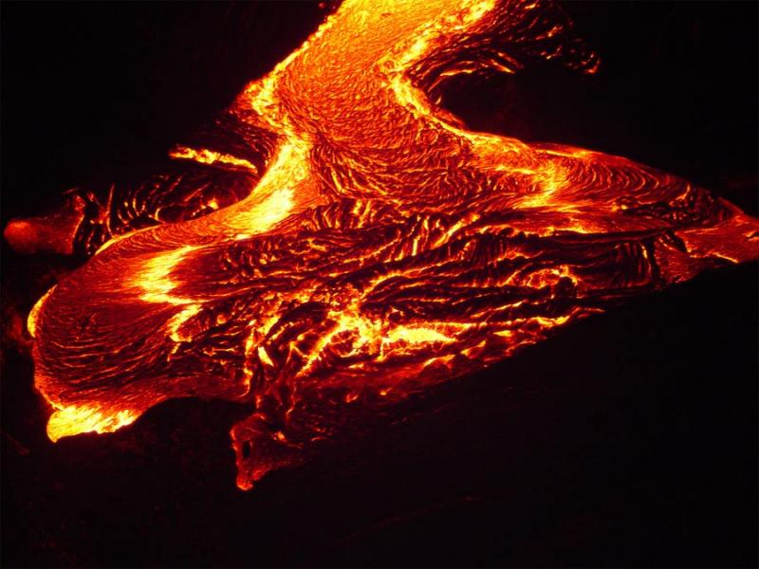
Liu’s projects
Fuego/LAVA integration

Slide 13
Wang’s project
busybox test suite (from scratch)

Slide 14
Discussion
(use the wiki page to record information)
http://fuegotest.org/Fuego_Jamboree_2

Slide 15
Fuego

Slide 16
Other Priorities
LAVA integration
We have everything needed for transport integration
Need test-level integration
Separate build phase (done)
Deploy to LAVA server
Create LAVA test that does:
Execute test on board
Collect results

